Slide 1
Numerical Analysis (6/7) Linear systems
University of Luxembourg - 2024
Master in Mathematics
Hadrien Beriot

Slide 2
Outline
1. Introduction
2. Direct Methods
3. Iterative methods
4. Summary

Slide 3

1. Introduction

Slide 4
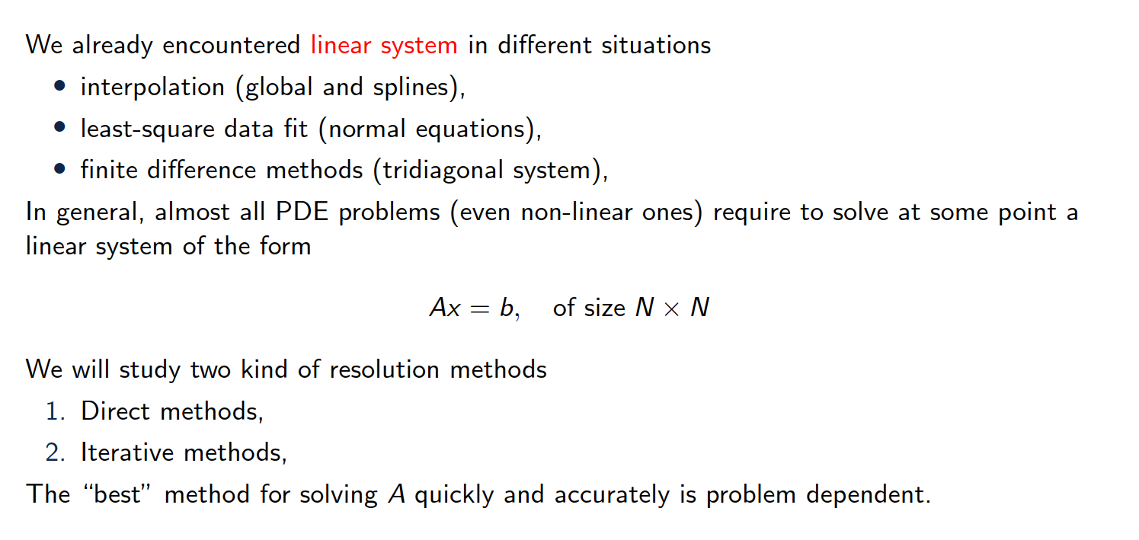
Overview of the content
Notes:
The image represents a Lorenz attractor, which is a three-dimensional chaotic attractor discovered by the mathematician Edward Lorenz.
The Lorenz attractor is a graphical representation of the solutions to a set of differential equations that describe a simplified model of atmospheric convection, known as the "Butterfly effect".
The image shows the characteristic butterfly-like shape of the Lorenz attractor, which demonstrates the sensitive dependence on initial conditions that is a hallmark of chaotic systems.

Slide 5
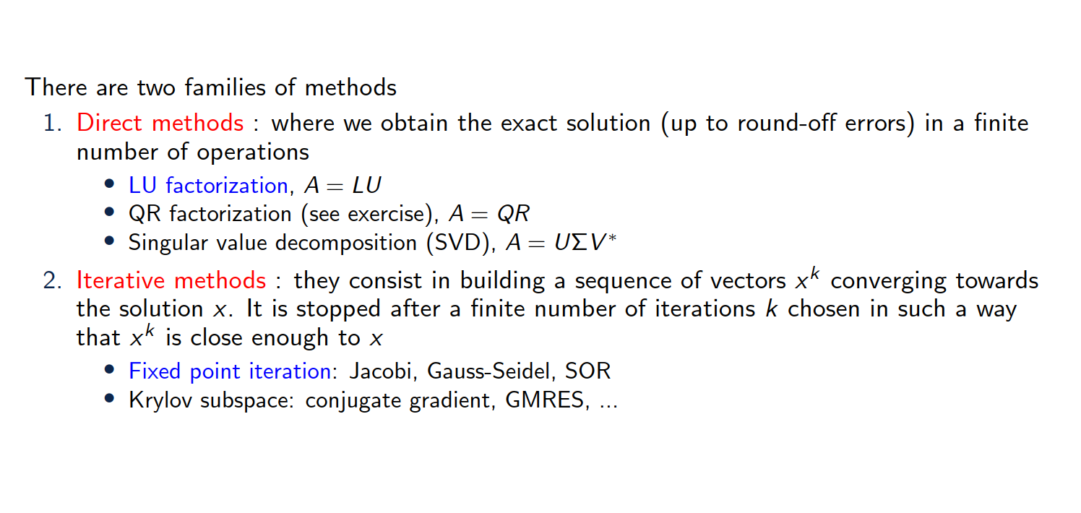
Overview of the content

Slide 6
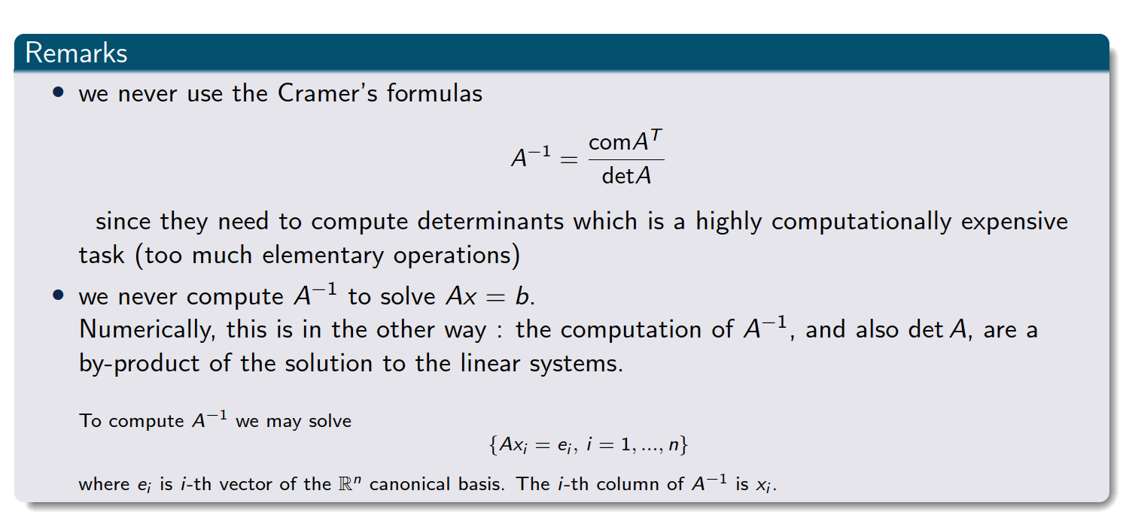
Important remarks
Notes:
The comatrix of a matrix AAA is the transpose of the matrix of cofactors of AAA.Each cofactor is obtained by calculating the determinant of the submatrix that remains after removing the row and column corresponding to the element in question, with an appropriate sign adjustment based on the position.

Slide 7
2. LU factorization

Slide 8
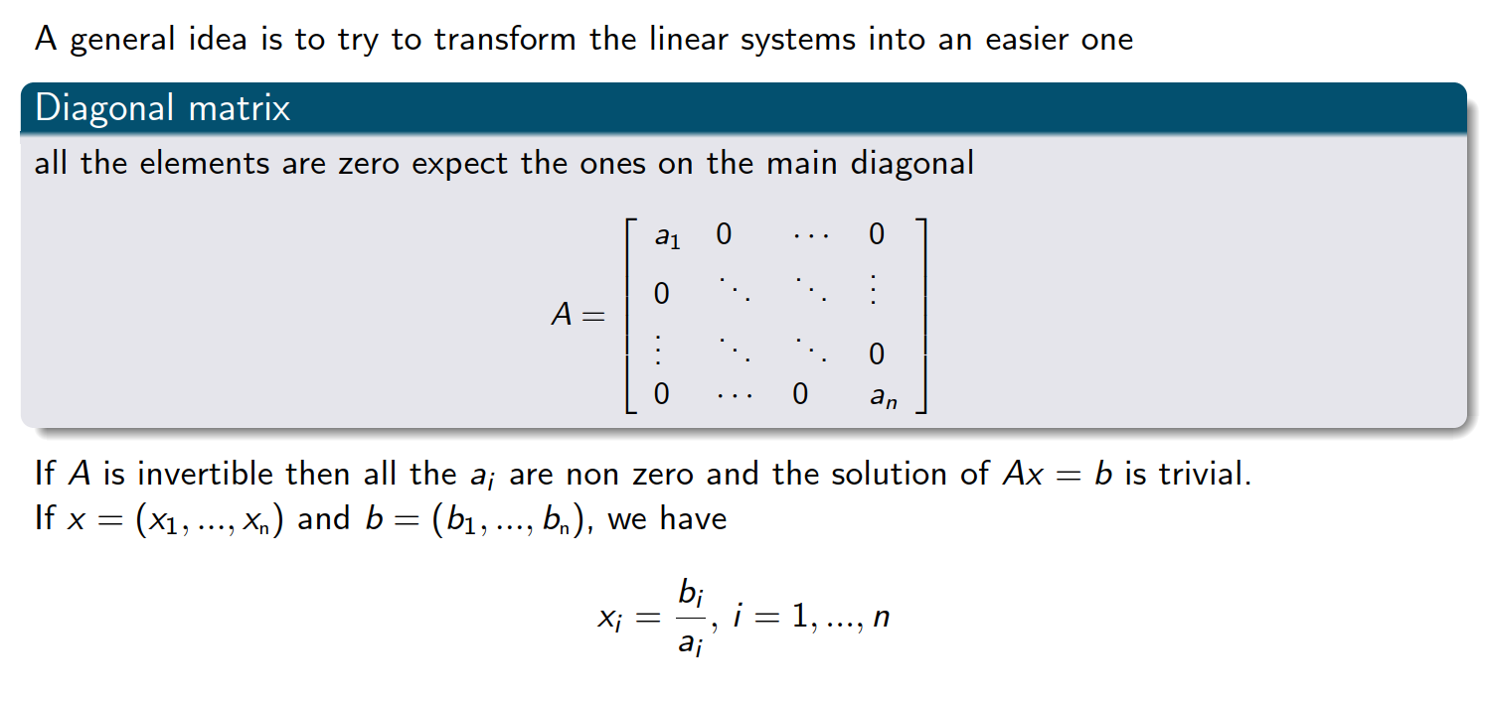
Linear system that is easy to solve

Slide 9
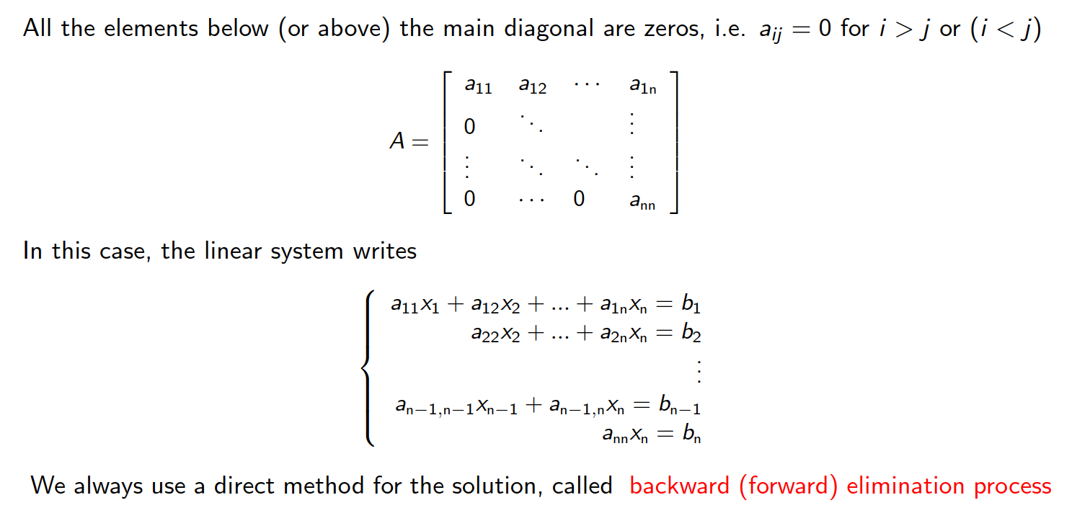
Upper (or lower) triangular matrices

Slide 10
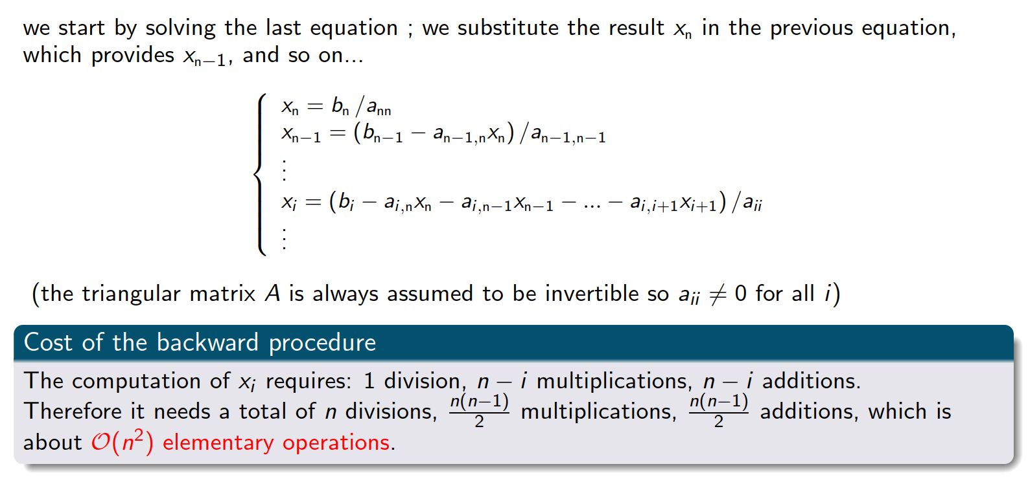
Backward substitution
Exercise 1

Slide 11
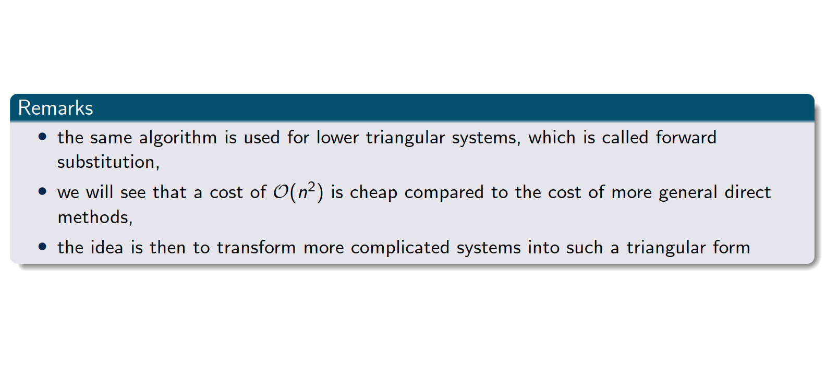
Upper (or lower) triangular matrices

Slide 12
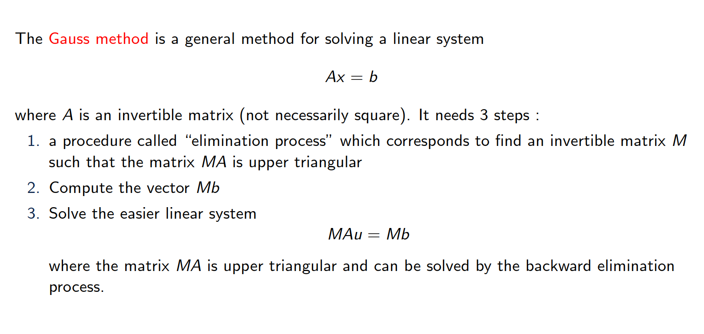
Gauss elimination

Slide 13
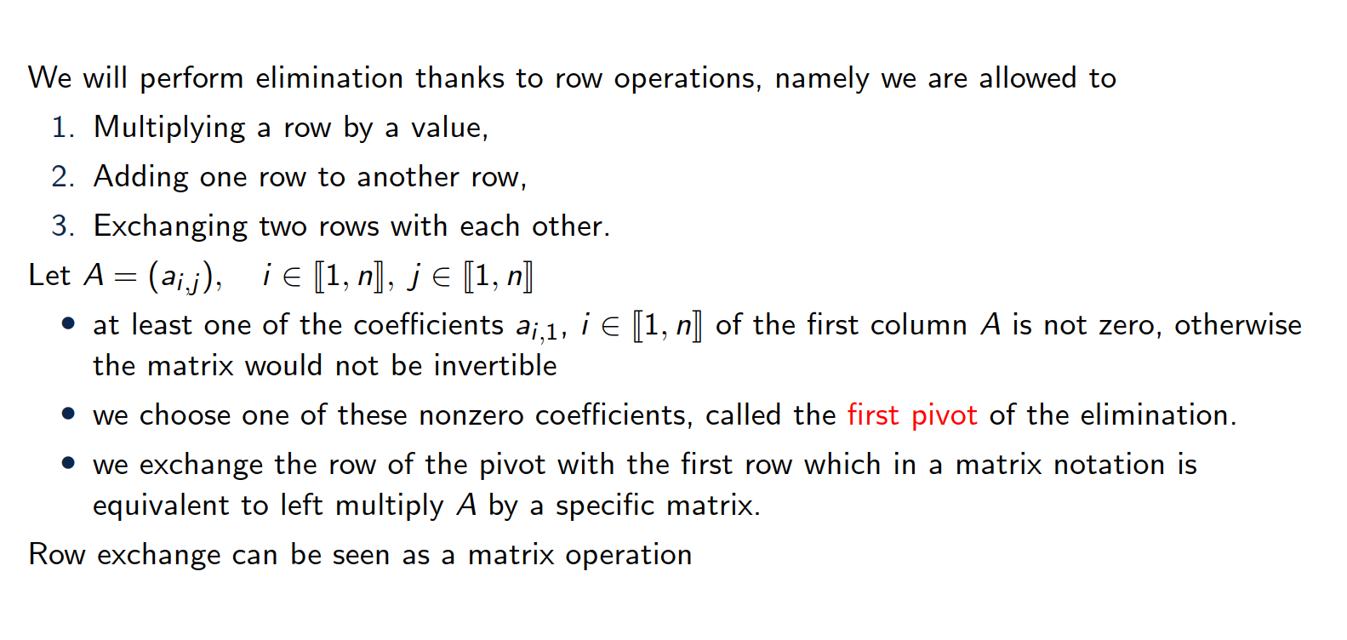
Description of the first step

Slide 14
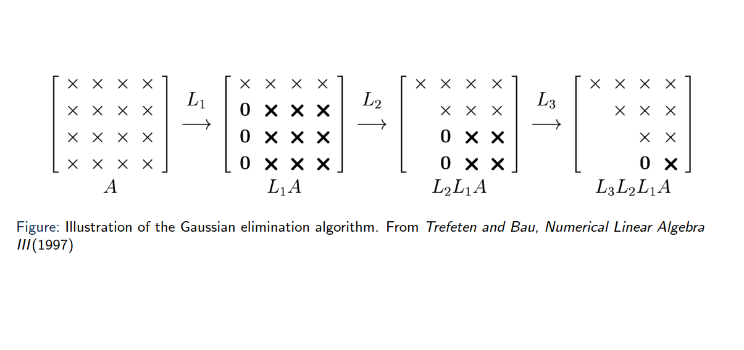
Illustration of the algorithm

Slide 15
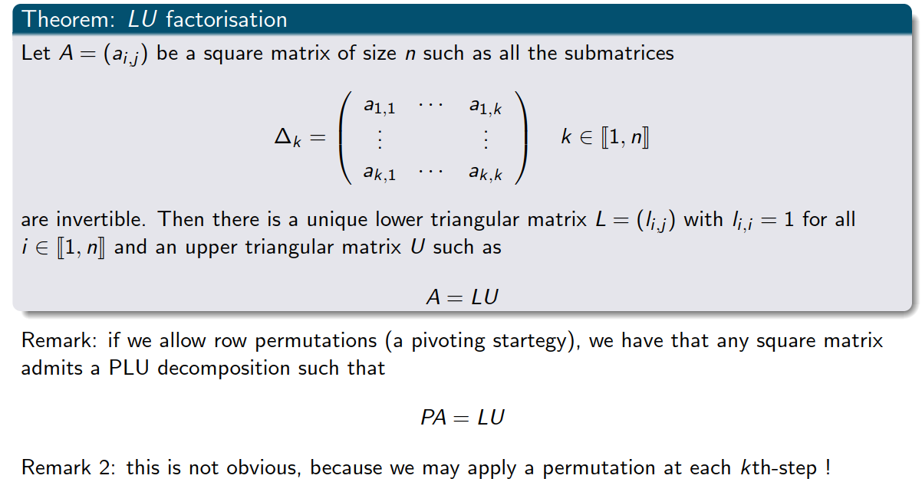
Theorem

Slide 16
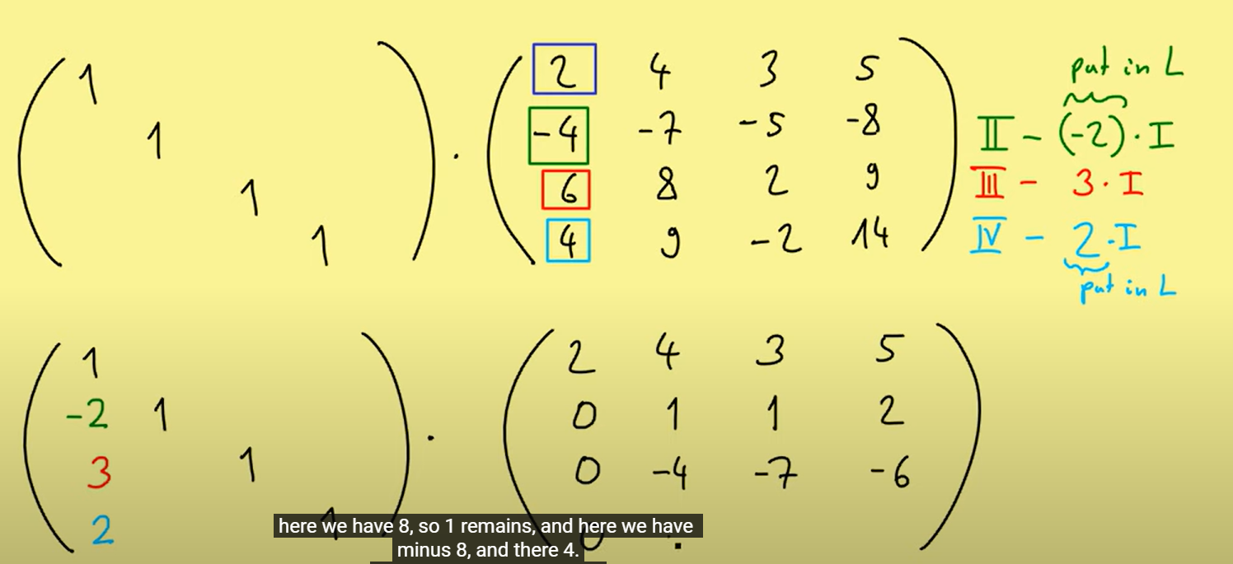
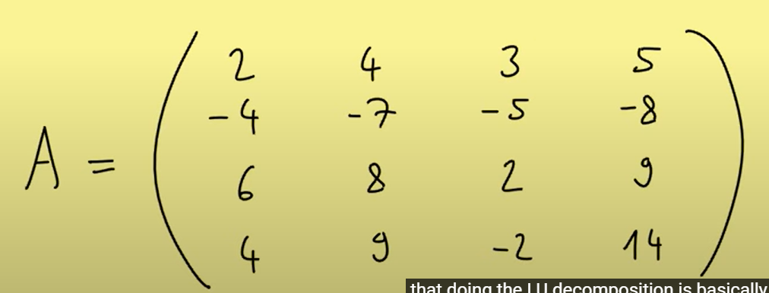
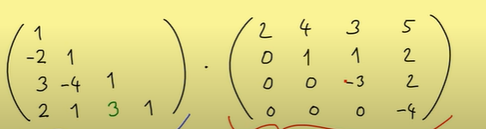
Example 4x4 linear system
https://www.youtube.com/watch?v=BFYFkn-eOQk
Notes:
Expanded Gaussian elimination

Slide 17
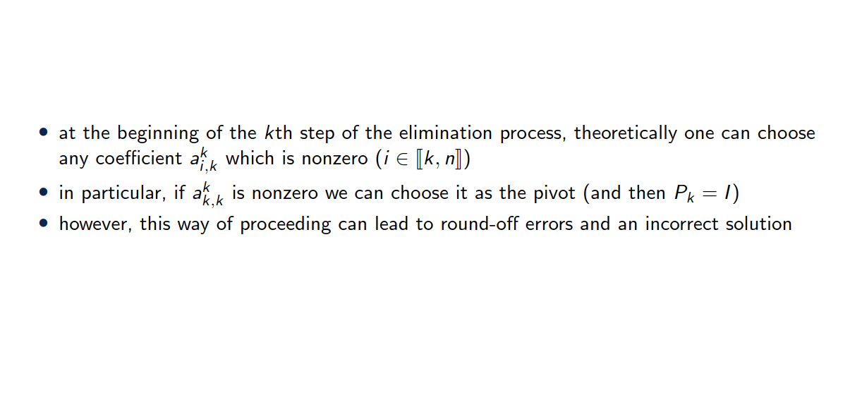
Choice of the pivot

Slide 18
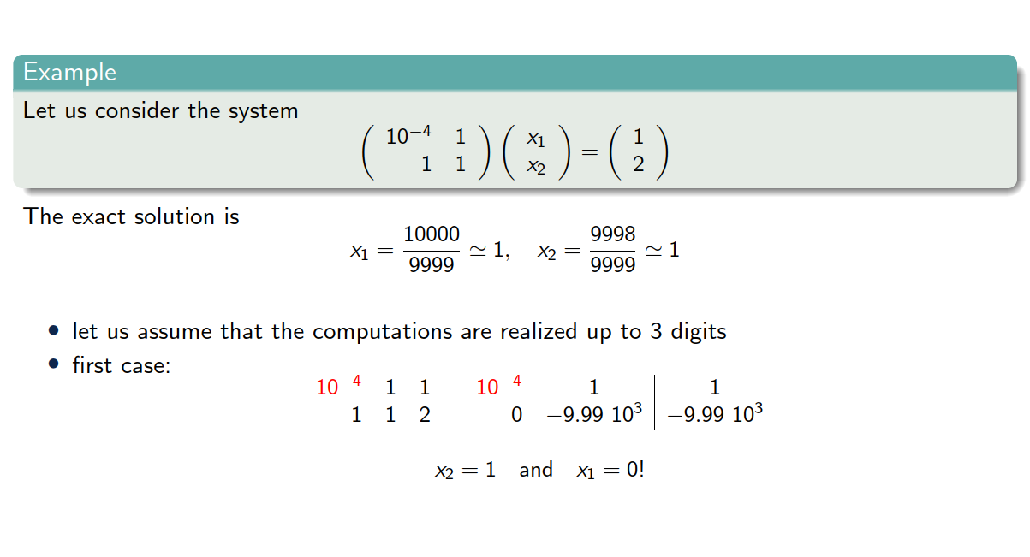
Choice of the pivot

Slide 19
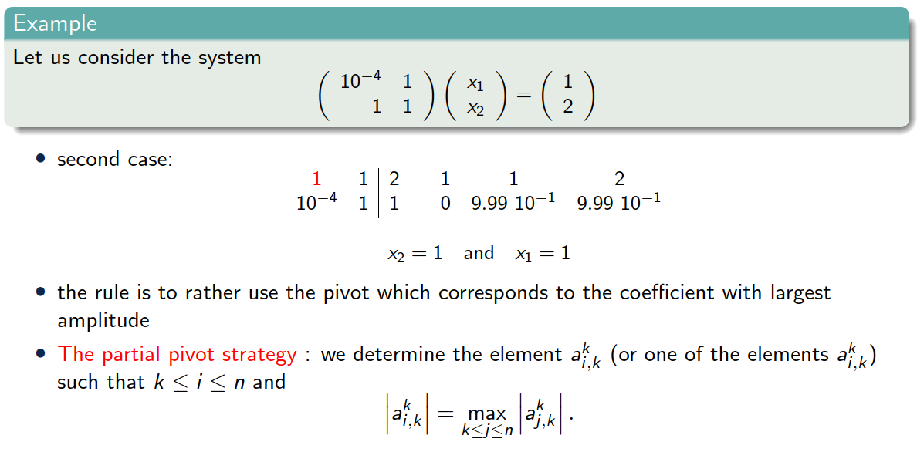
Choice of the pivot

Slide 20
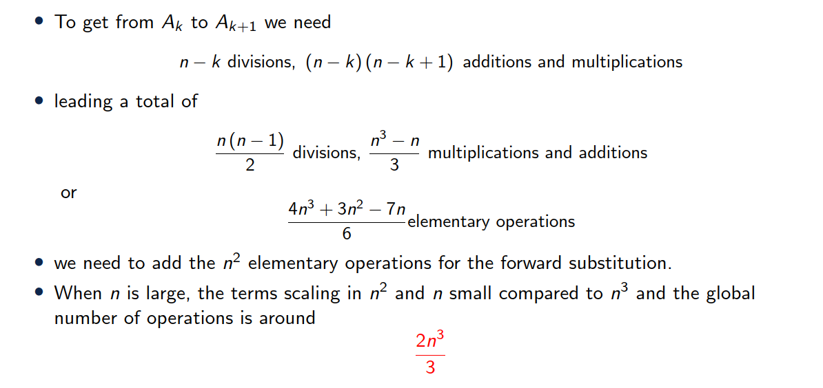
Cost of Gauss method

Slide 21
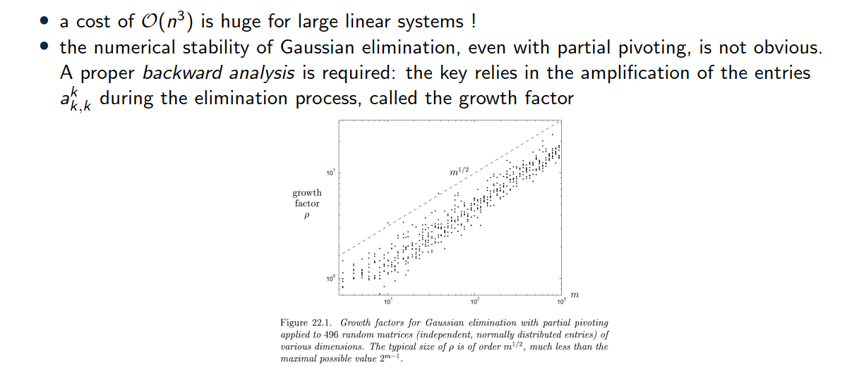
Remarks

Slide 22
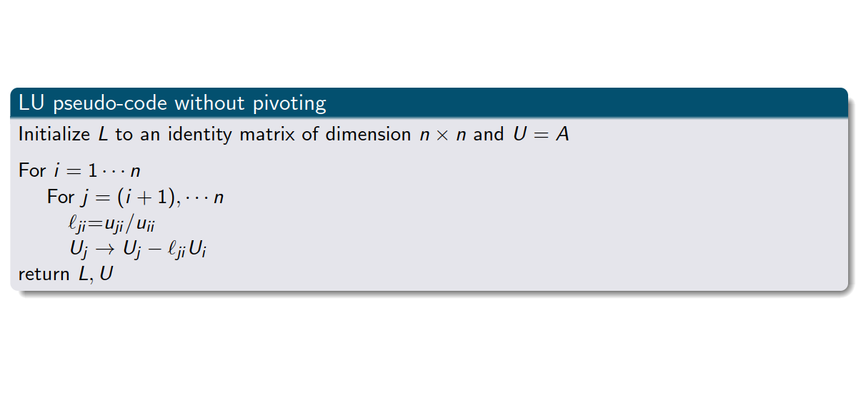
LU factorization pseudo-code

Slide 23
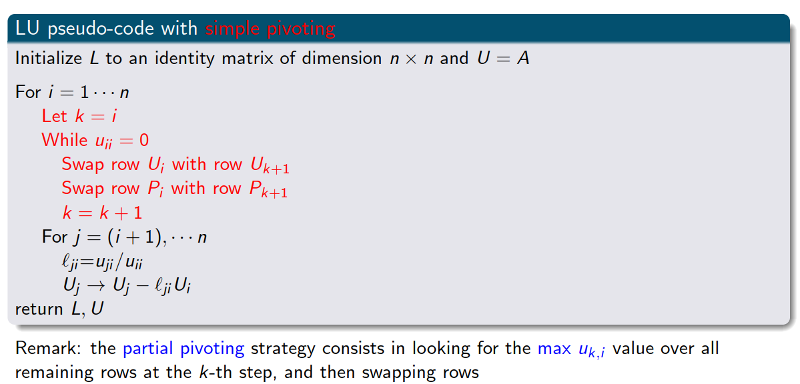
LU factorization pseudo-code with pivoting

Slide 24
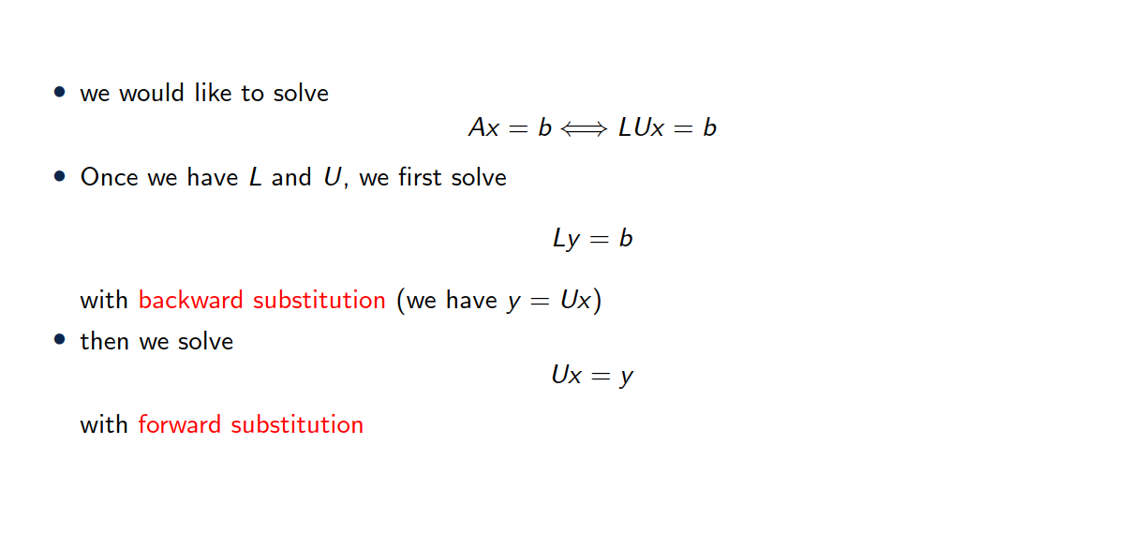
Solving a linear system with LU factorization

Slide 25
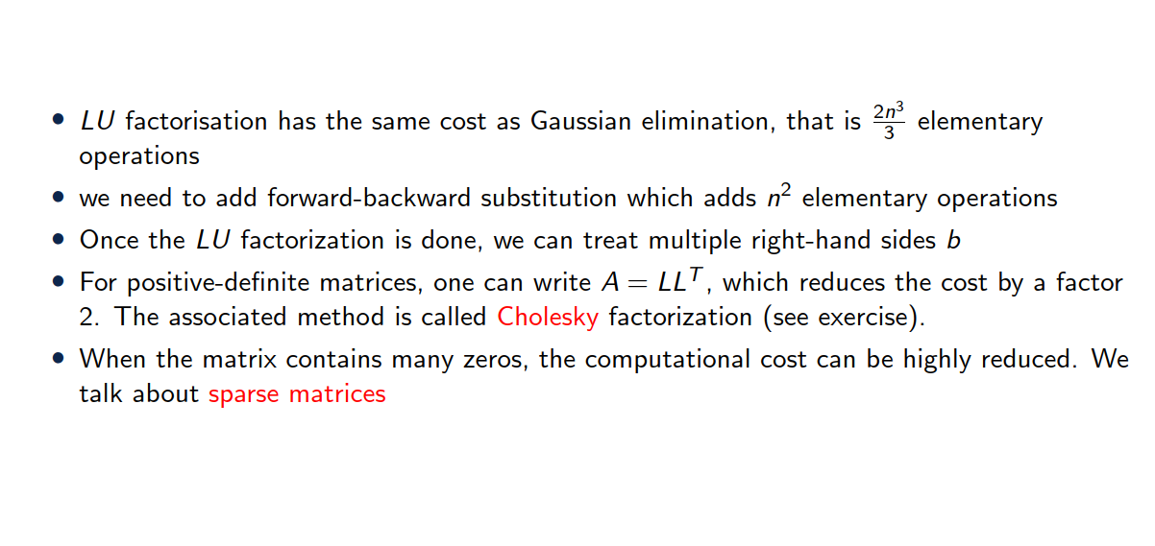
Factorization cost

Slide 26
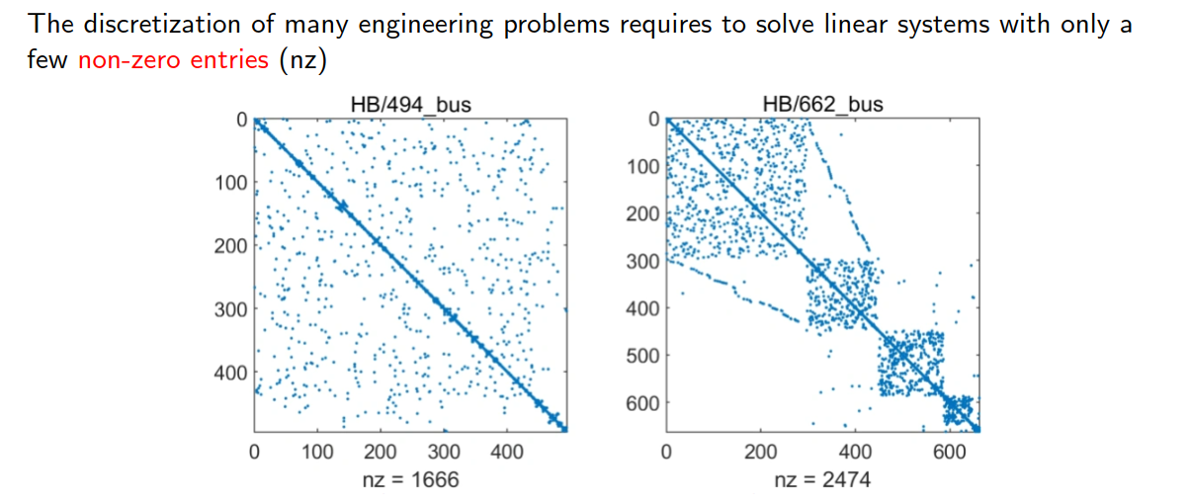
A few words on sparse matrices

Slide 27
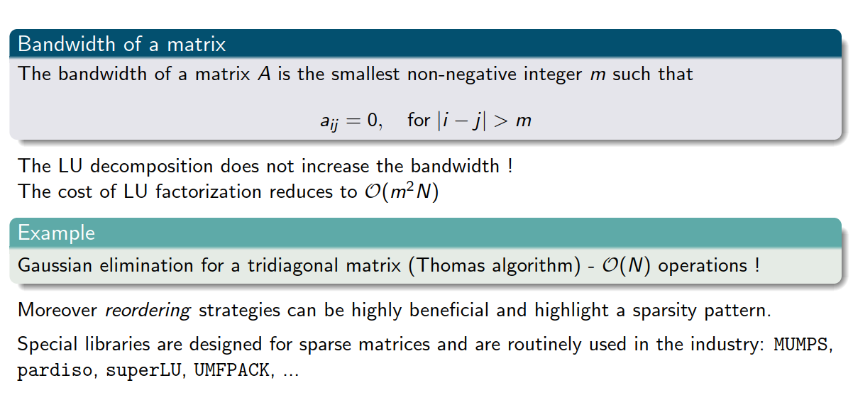
A few words on sparse matrices

Slide 28
3. QR algorithm

Slide 29
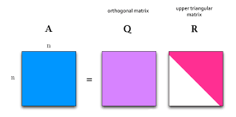

QR decomposition (for square matrices)
Exercise 3
Definition:
Any $n×n$ matrix $A$ can be decomposed into:
$Q$: A matrix with orthonormal columns ($Q^{T}Q=I$)
$R$: An upper triangular matrix
Steps for Decomposition:
Classical Approach: Gram-Schmidt orthogonalization process.
Alternative Methods: Householder reflections or Givens rotations
Applications: Often used in least-squares problems and eigenvalue problems.

Slide 30
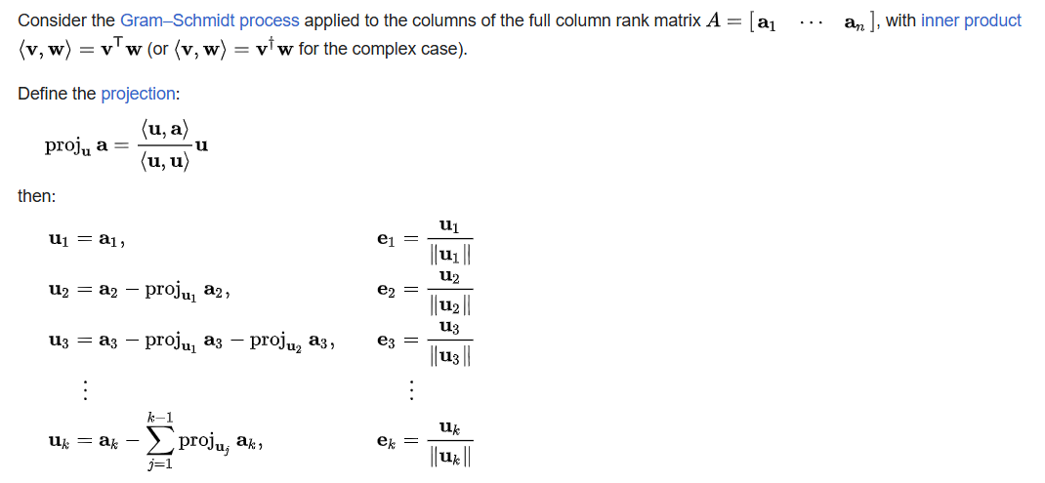
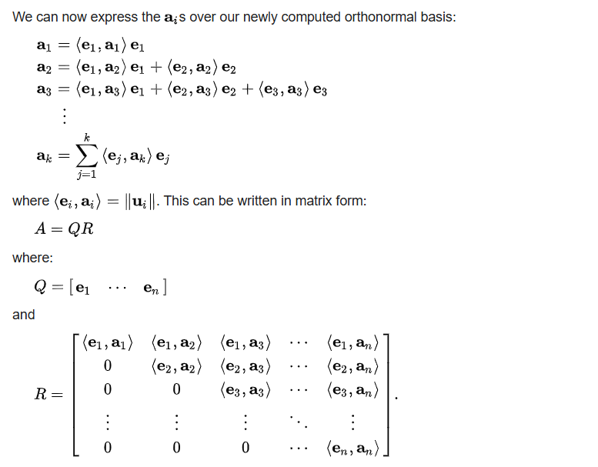
QR decomposition
https://en.wikipedia.org/wiki/QR_decomposition

Slide 31
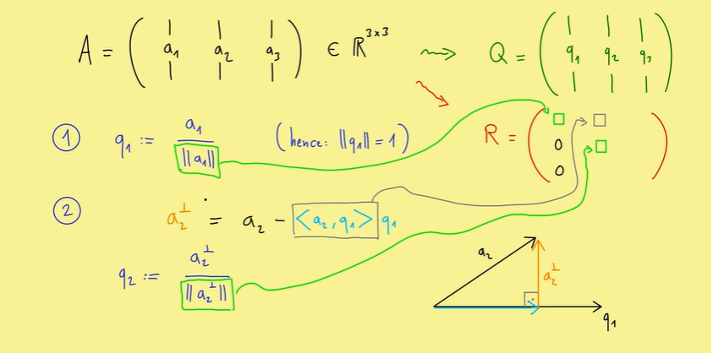
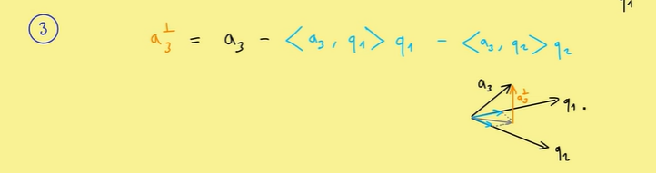
QR algorithm
https://www.youtube.com/watch?v=FAnNBw7d0vg&t=3s

Slide 32
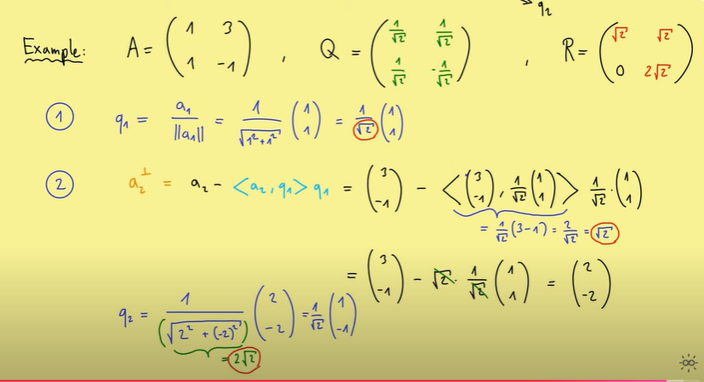
Example (hands on)

Slide 33
3. Iterative solvers

Slide 34
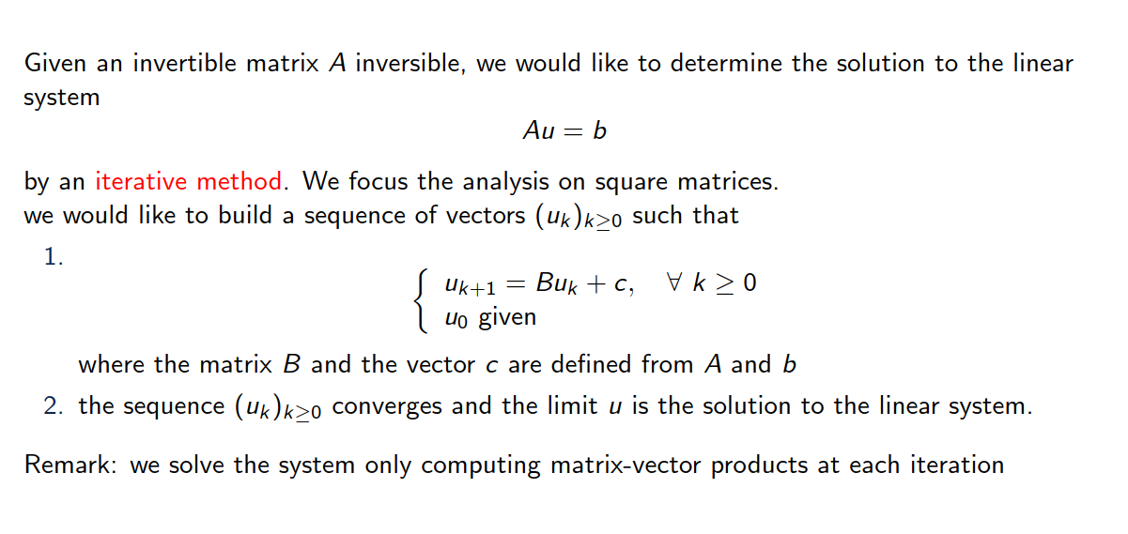
Introduction

Slide 35
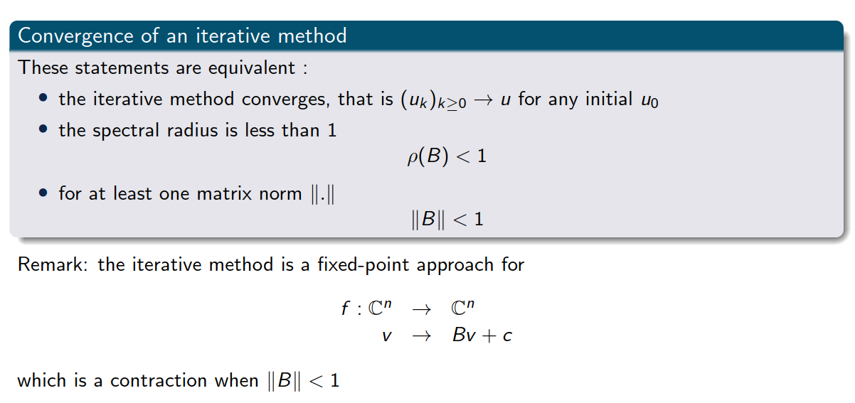
Some basic notions

Slide 36
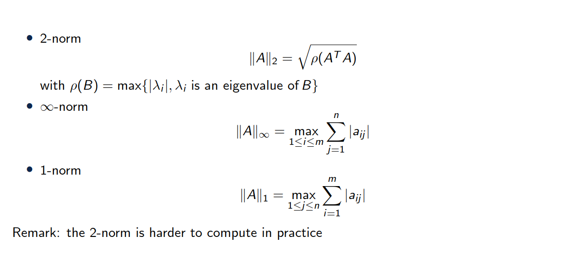
Some induced matrix norms

Slide 37
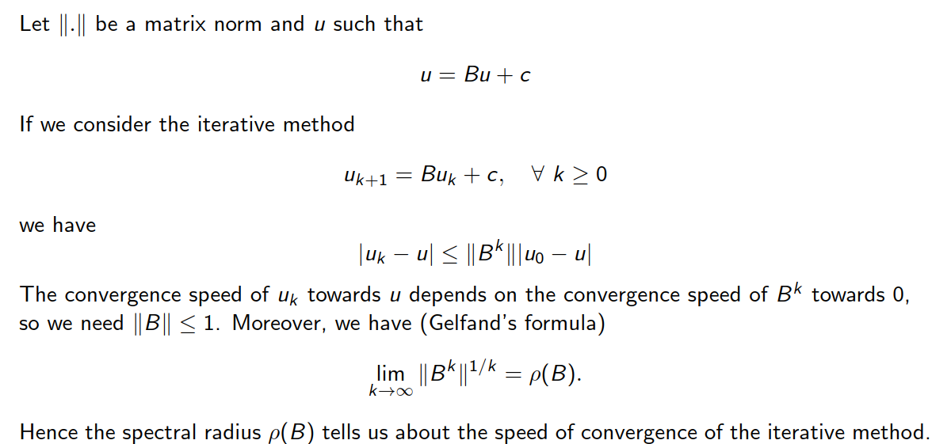
Speed of convergence

Slide 38
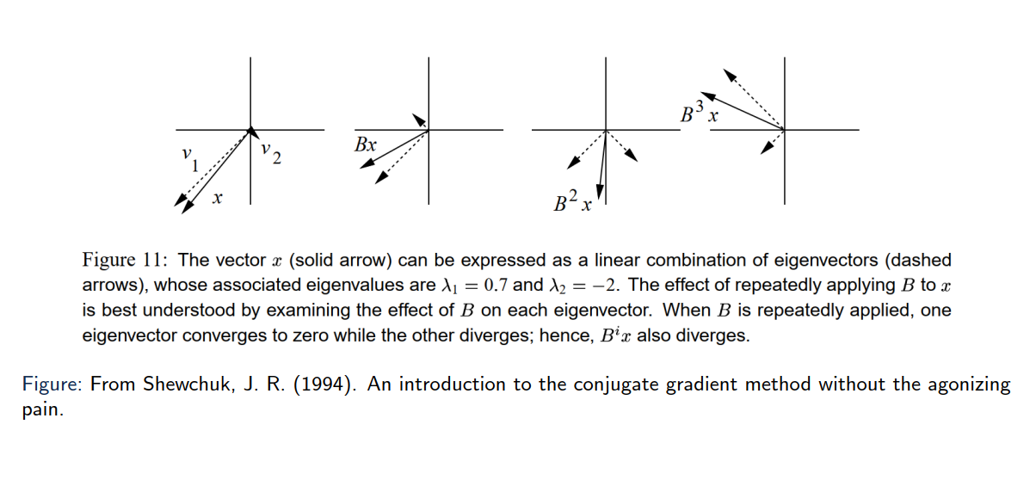
Some basic notions
Eigen vectors only get scaled, not changed in direction!

Slide 39
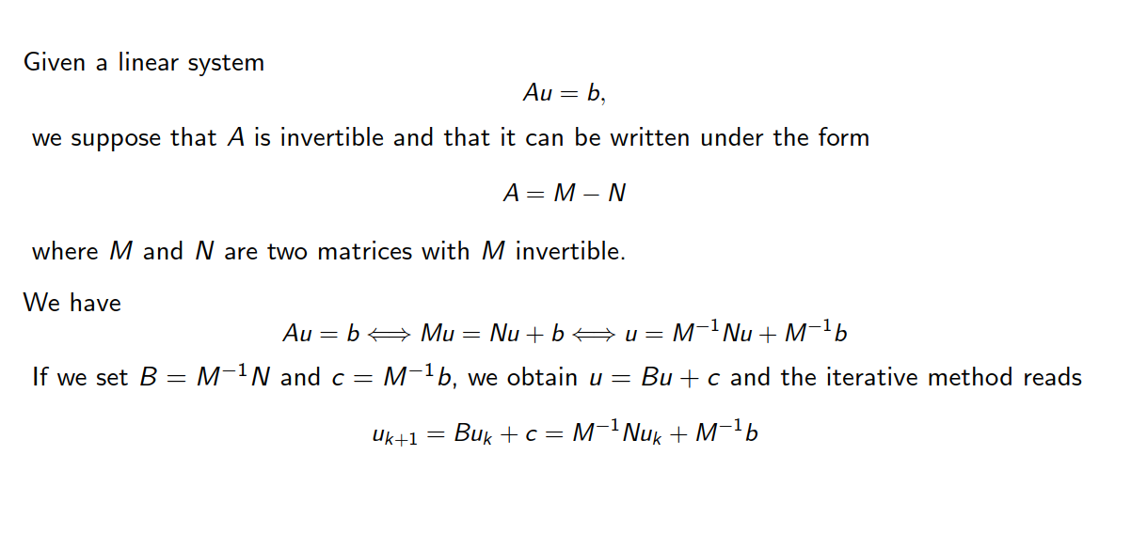
Another matrix decomposition

Slide 40
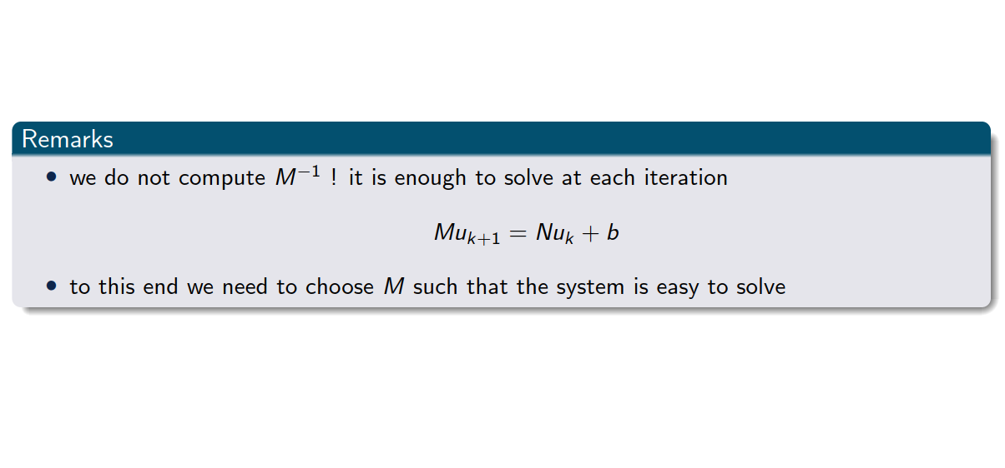
Another matrix decomposition

Slide 41
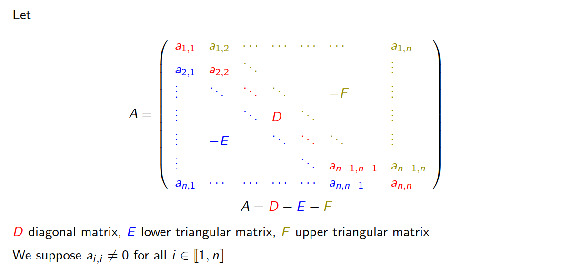
Towards a decomposition of A

Slide 42
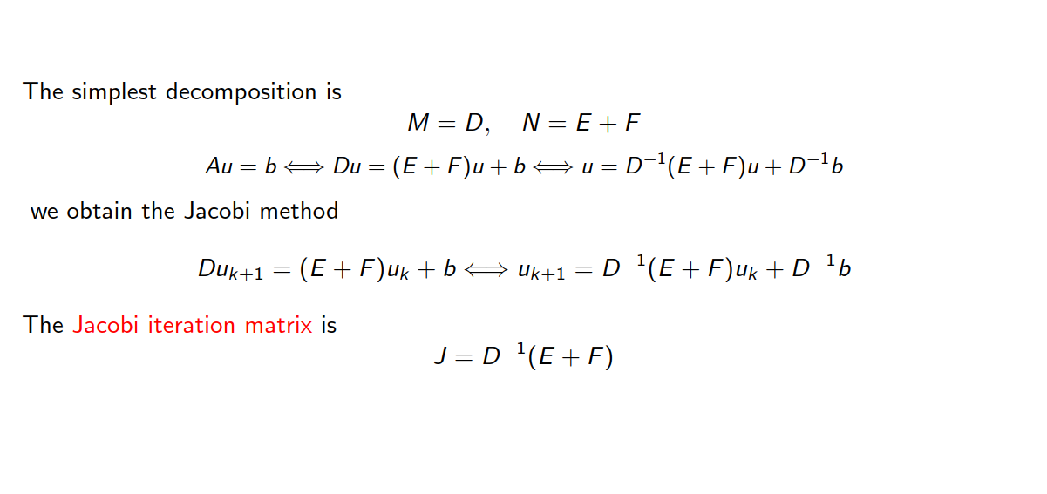
Jacobi iterative method

Slide 43
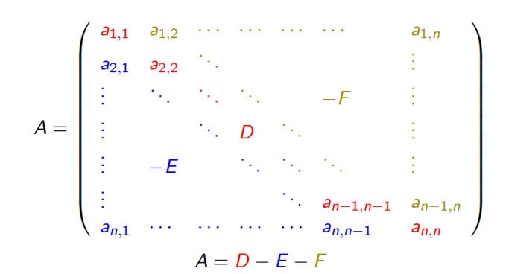
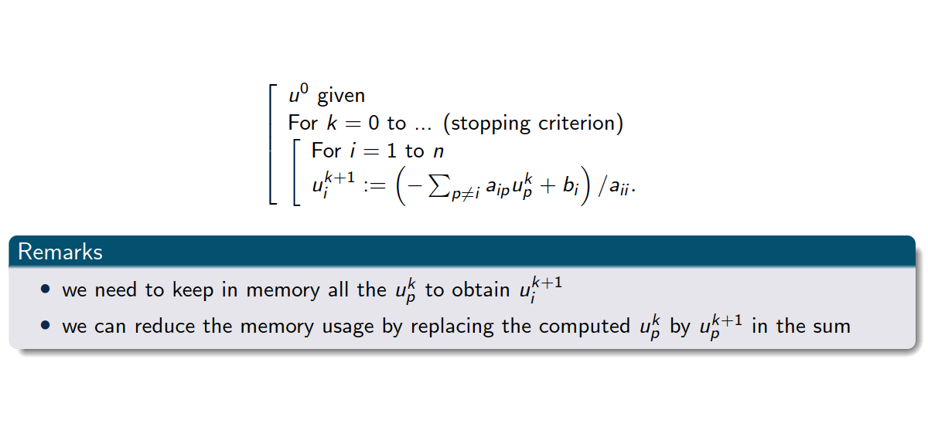
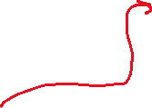
Jacobi iterative method
Pseudo code

Slide 44
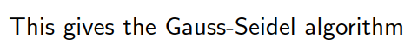

Gauss Seidel algorithm
Pseudo code

Slide 45
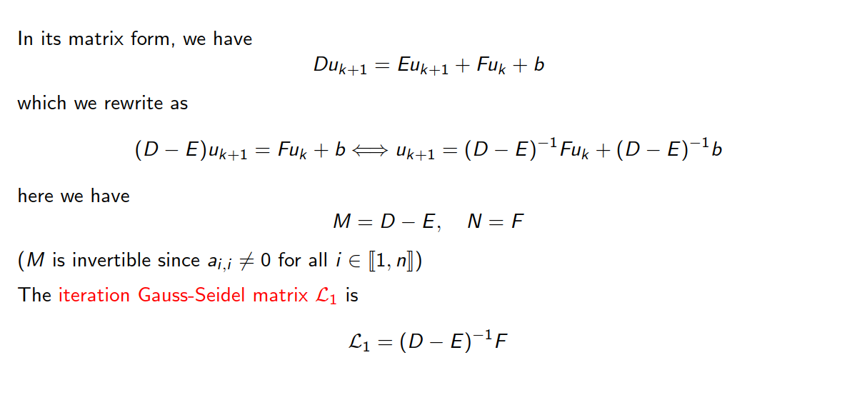
Gauss-Seidel iterative method

Slide 46
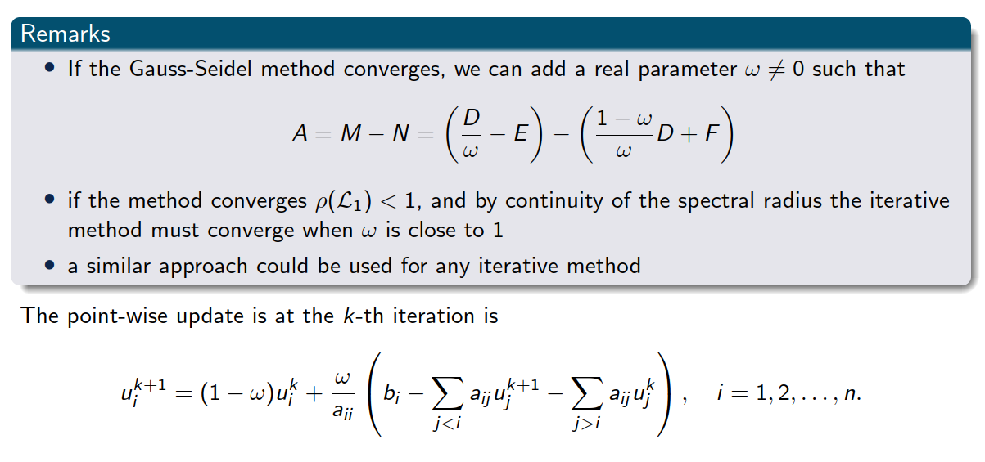
Relaxation method: Successive over-relaxation (SOR)

Slide 47











Relaxation method: Successive over-relaxation (SOR)

Slide 48
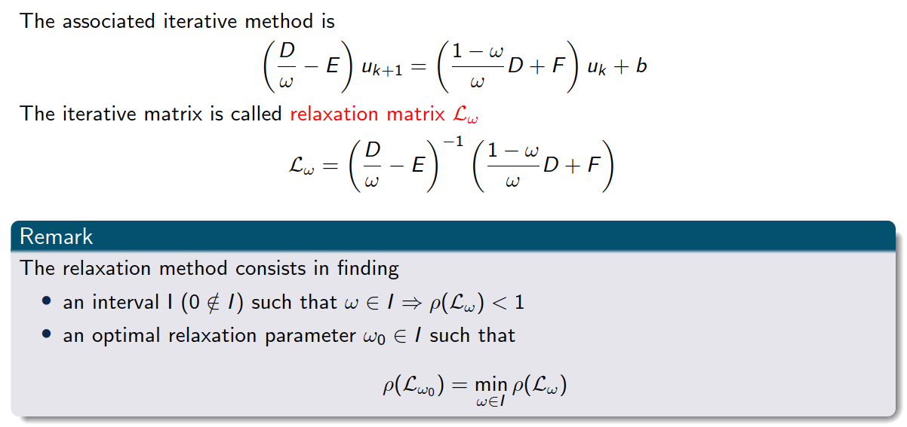
Relaxation method: Successive over-relaxation (SOR)

Slide 49
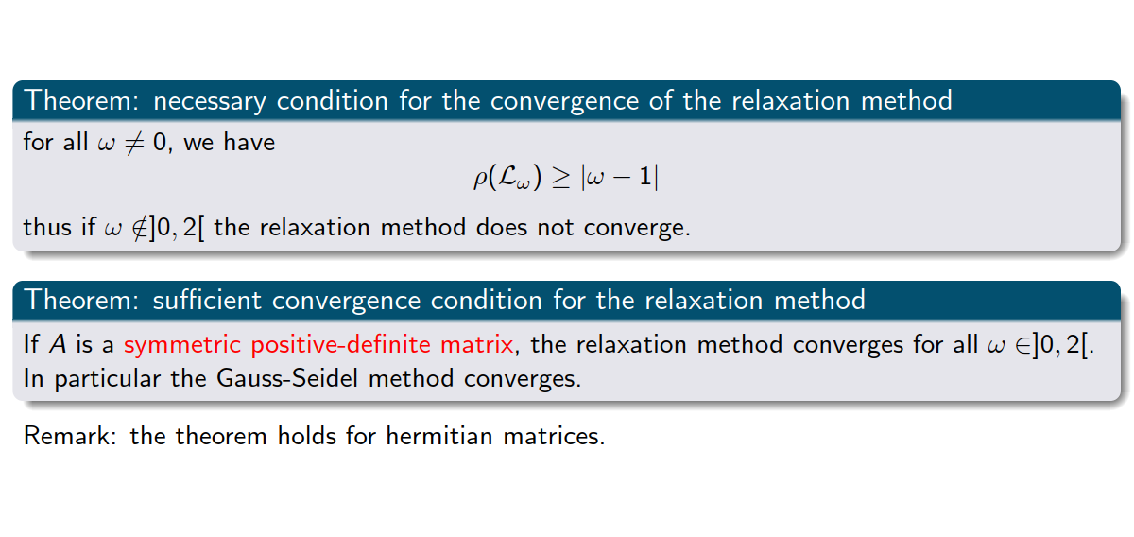
Convergence of SOR

Slide 50
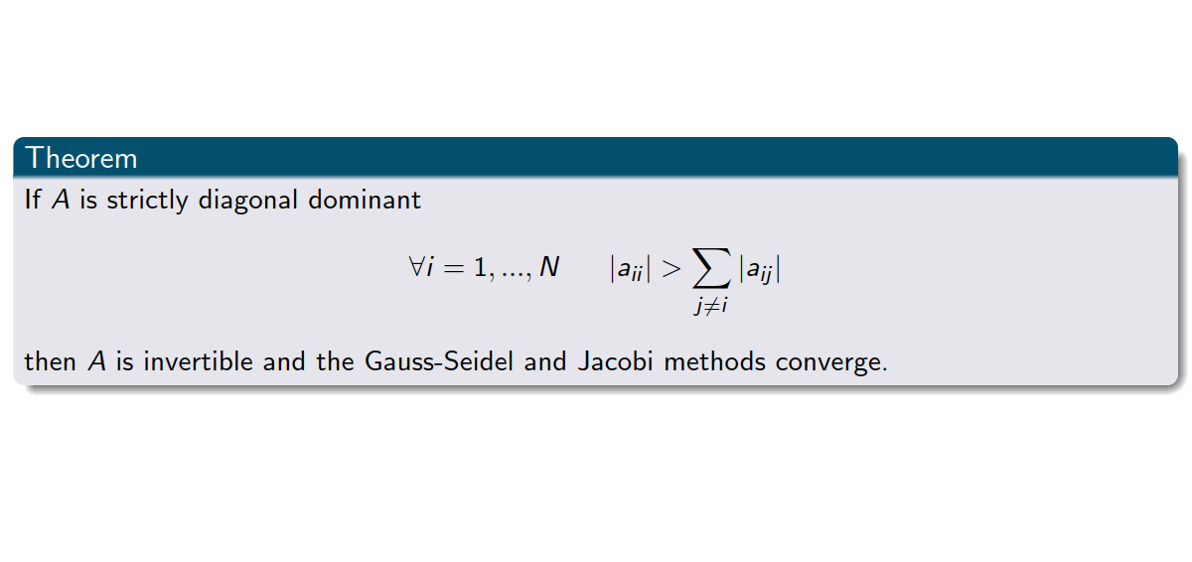
Convergence of Gauss-Seidel and Jacobi

Slide 51
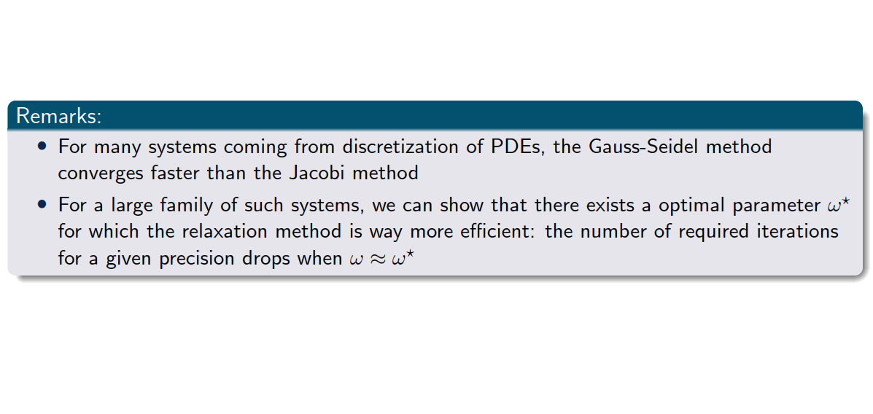
In general

Slide 52

Matrices of type “V”

Slide 53

Matrices of type “V”

Slide 54

A few words about conditioning

Slide 55

A few words about conditioning

Slide 56
6. Summary

Slide 57

Summary

